Slide 1
Using PowerShell for Active Directory
Ashley McGlone | Premier Field Engineer, Microsoft
Jason Helmick | Senior Technologist, Concentrated Technology

Slide 2
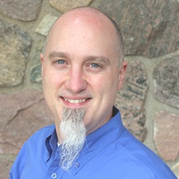
Meet Ashley McGlone | @GoateePFE
Senior Premier Field Engineer, Microsoft
Supporting Active Directory and PowerShell
PowerShell workshop author and instructor
Popular TechNet blogger
Seasoned IT pro of 15 years
Frequent speaker at industry events
PowerShell Deep Dives chapter author
MCP since 1998 (MCT, MCSE, MCITP, etc.)
Started with a Commodore VIC20 in 1982!
Twitter, Facebook, TechNet @GoateePFE | Blog http://aka.ms/GoateePFE

Slide 3
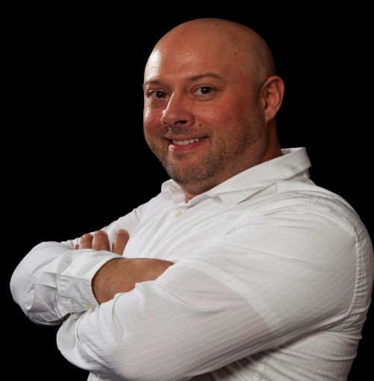
Meet Jason Helmick | @theJasonHelmick
Senior Technologist, Concentrated Technology
CFO – PowerShell.Org
Author “Learn Windows IIS in a Month of Lunches”
Windows PowerShell MVP
25 year IT veteran
Speaker and several industry conferences
Teaches PowerShell to the IT pro for automation of products such as MS Exchange, SharePoint and IIS.
Frequent contributor to magazines TechNet, Redmond and TechTarget
Detailed comment, such as SME’s hometown and some personal details, such as family, sports, hobbies, etc.

Slide 4
Course Modules
Active Directory PowerShell JumpStart and Video on Demand Modules
01 | Introduction to Active Directory PowerShell Overview of AD PowerShell, versions, requirements and more
02 | Working with users and groups Routine management tasks, create, modify, enable, disable, unlock and more
03 | Querying AD data Learn techniques for querying efficiently for report data
04 | Forensic investigations and lockouts Answer the question “Who did this?” Track when you data was changed
05 | Stale Object Cleanup Cleaning up users, groups and more
06 | Managing and Troubleshooting AD Replication Work with sites, subnets, and Trusts with PowerShell
07 | Recovery Prevent accidental deletion using the Recycle Bin. Recover deleted objects
08 | Deploying Domain Controllers Learn the alternatives to using DCPROMO and automate your DC builds

Slide 5
Setting Expectations
Tailored for the IT pro that needs to get up to speed fast on AD with PowerShell
Real world Tips and Tricks
Fast paced for the busy IT pro
Action packed demos that can be reviewed from this recording
Get up to speed – Getting Start with PowerShell 3.0 JumpStart

Slide 6
Links and books for more information
http://aka.ms/MVAPSAD
http://aka.ms/MVAPremier
Managing Active Directory with Windows PowerShell: TFM, 2nd Edition by Jeffery Hicks (Apr 1, 2011)
Automating Active Directory Administration with Windows PowerShell 2.0 by Ken St. Cyr and Laura E. Hunter (Jun 28, 2011)
Learn Active Directory Management in a Month of Lunches by Richard Siddaway (Mar 24, 2014)

Slide 7
01 | Introduction to Active Directory PowerShell
Ashley McGlone | Premier Field Engineer, Microsoft
Jason Helmick | Senior Technologist, Concentrated Technology

Slide 8
Module Overview
Version History
Getting Started
ADAC History
One-Liners

Slide 9
Version History

Slide 10
Active Directory PowerShell History
Former Scripting Technologies
2008 R2 (v1) 76 cmdlets
2012 (v2) +69 cmdlets
WMI
ADODB
CMD utilities
ADSI (.NET foundation)
2012 R2 (v3) +12 cmdlets
Forest, Domain
Users, Groups, Computers, OUs
Service Accounts
Password Policies
Recycle Bin
Etc.
Replication
Trusts
DC Cloning
Dynamic Access Control
ADDSDeployment Module
Authentication Policies

Slide 11
Getting Started

Slide 12
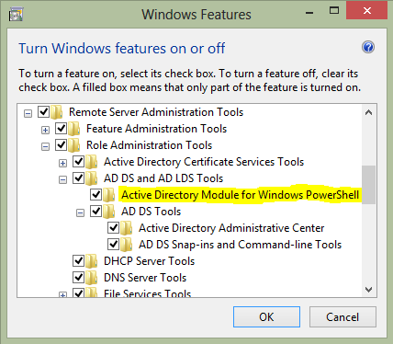
Active Directory PowerShell Versions
Client – RSAT AD PS Module
Server – DC with AD Web Service
v1
Windows 7
Windows Server 2008 R2
v2
Windows 8
Windows Server 2012
v3
Windows 8.1
Windows Server 2012 R2
Windows Server 2003 or 2008
AD Management Gateway Service
http://aka.ms/ADPS2003
Windows Server 2008 R2
Windows Server 2012
Windows Server 2012 R2
AD Cmdlet
Feature Level
Port 9389

Slide 13
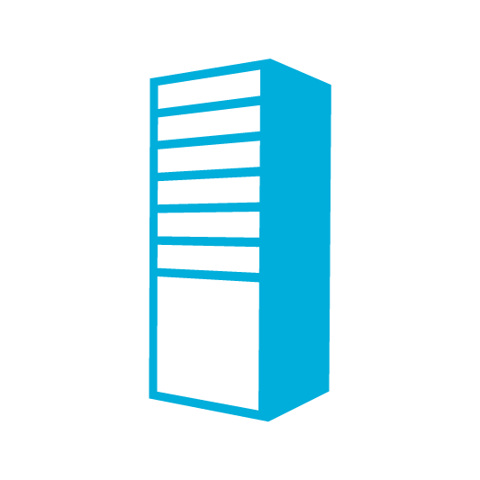


Active Directory PowerShell Implicit Remoting
4. Get-ADReplicationSubnet
≥
1. New-PSSession
2. Import-Module -PSSession
Windows Server 2003/2008
Domain Controller
4. Get-ADReplicationSubnet
3. Get-ADReplicationSubnet
5. Serialized Results
Windows 7
PowerShell 3.0 / 4.0
Windows Server 2012 / R2
Domain Controller
4. Get-ADReplicationSubnet
Windows Server 2008R2
Domain Controller
http://aka.ms/ADPS2012
Windows Server 2012 / R2
Domain Controller

Slide 14
ADAC History

Slide 15
One-Liners

Slide 16
Links and books for more information
http://aka.ms/MVAPSAD
http://aka.ms/MVAPremier
Managing Active Directory with Windows PowerShell: TFM, 2nd Edition by Jeffery Hicks (Apr 1, 2011)
Automating Active Directory Administration with Windows PowerShell 2.0 by Ken St. Cyr and Laura E. Hunter (Jun 28, 2011)
Learn Active Directory Management in a Month of Lunches by Richard Siddaway (Mar 24, 2014)

